Slide 1
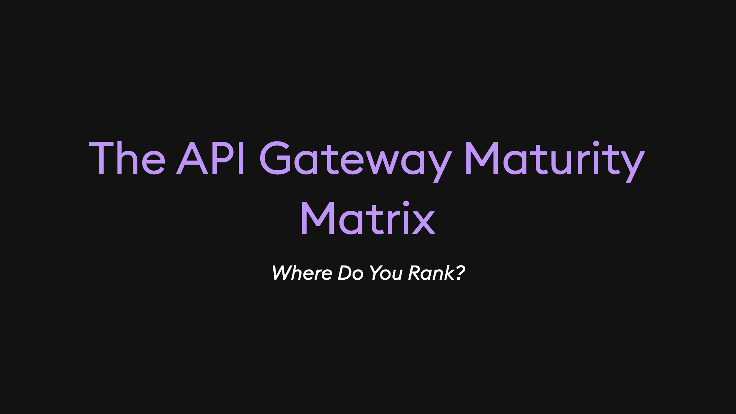
Notes:
FOR NGROK Okay, Sam gave me the really good but very terrifying idea of asking the entire company for feedback on my upcoming KubeCon talk about the idea of API gateway maturity. FOR KUBECON About me: I'm Joel, and I do all things DevRel at ngrok, the universal gateway company. I love stories, so let me start with a short one loosely based on ngrok itself.

Slide 2
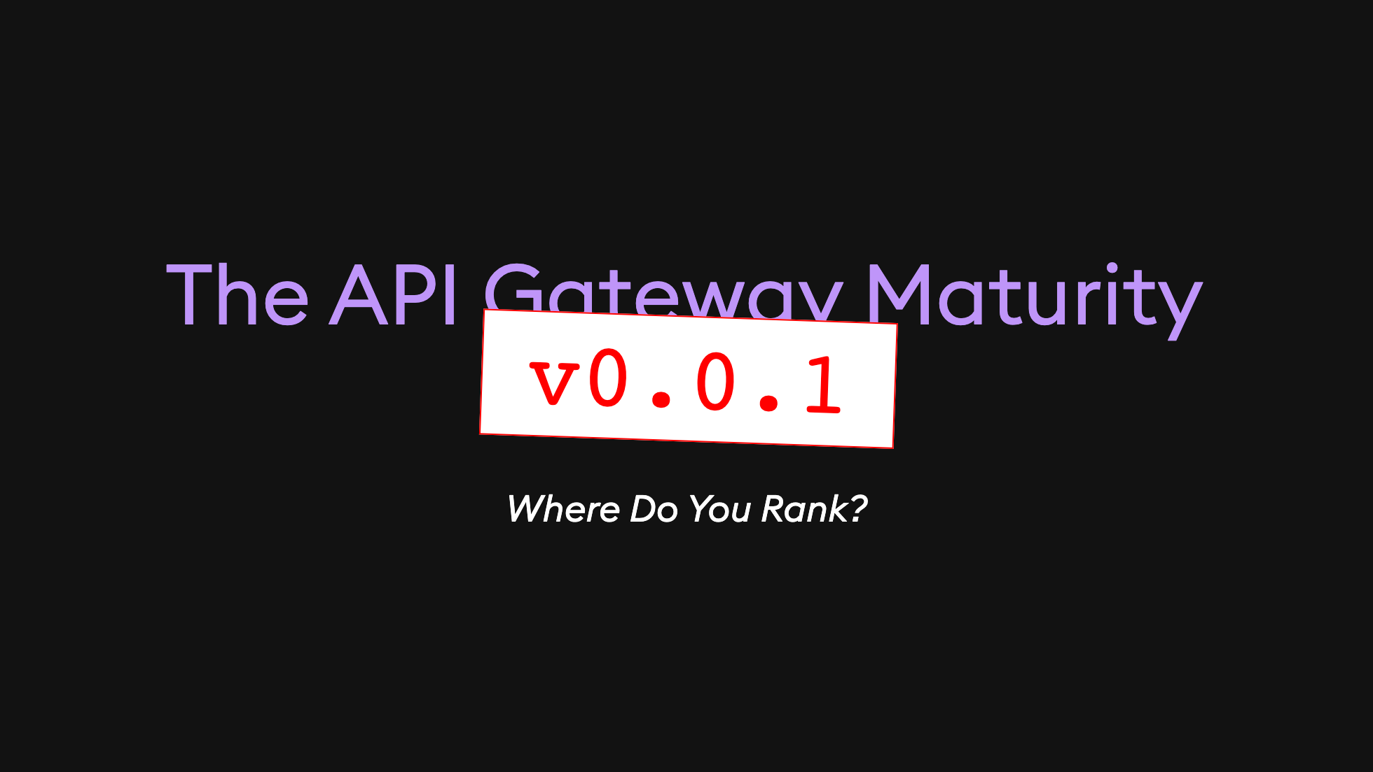
Notes:
FOR NGROK Okay, Sam gave me the really good but very terrifying idea of asking the entire company for feedback on my upcoming KubeCon talk about the idea of API gateway maturity. FOR KUBECON About me: I'm Joel, and I do all things DevRel at ngrok, the universal gateway company. I love stories, so let me start with a short one loosely based on ngrok itself.

Slide 3
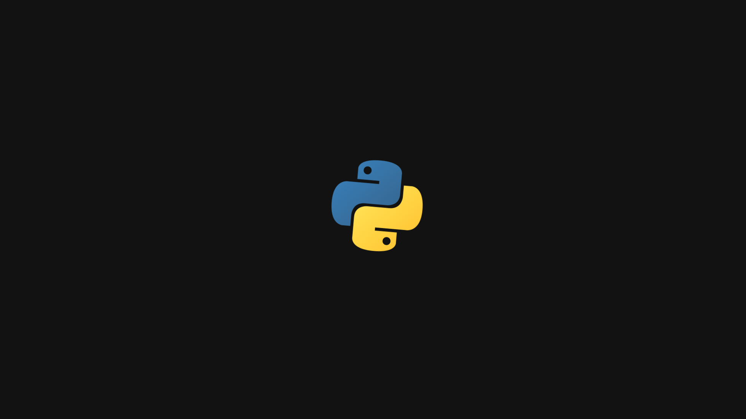
Notes:
It starts with just a simple Python app. It's a one-page marketing site and the rest of the backend. Then at some point you need to slap NGINX on it. You need that reverse proxy, and NGINX is free and trusted. Then you decide, wait, let's go Kubernetes. Slap that on there. Nice easy project. Oh look, some new API services want to sneak in behind your proxy. And there's Docusaurus, asking for a little space for your new developer documentation. Slap that on there. What's that? The dreaded Webflow peeking in? I'm sure many of you have been in this situation before. To get all this working, your NGINX proxy is all of a sudden full of complex routing rules and traffic management policies. All your security in a configuration that's both strict and verbose. It's a front door, but it's a fragile one.

Slide 4

Notes:
It starts with just a simple Python app. It's a one-page marketing site and the rest of the backend. Then at some point you need to slap NGINX on it. You need that reverse proxy, and NGINX is free and trusted. Then you decide, wait, let's go Kubernetes. Slap that on there. Nice easy project. Oh look, some new API services want to sneak in behind your proxy. And there's Docusaurus, asking for a little space for your new developer documentation. Slap that on there. What's that? The dreaded Webflow peeking in? I'm sure many of you have been in this situation before. To get all this working, your NGINX proxy is all of a sudden full of complex routing rules and traffic management policies. All your security in a configuration that's both strict and verbose. It's a front door, but it's a fragile one.

Slide 5
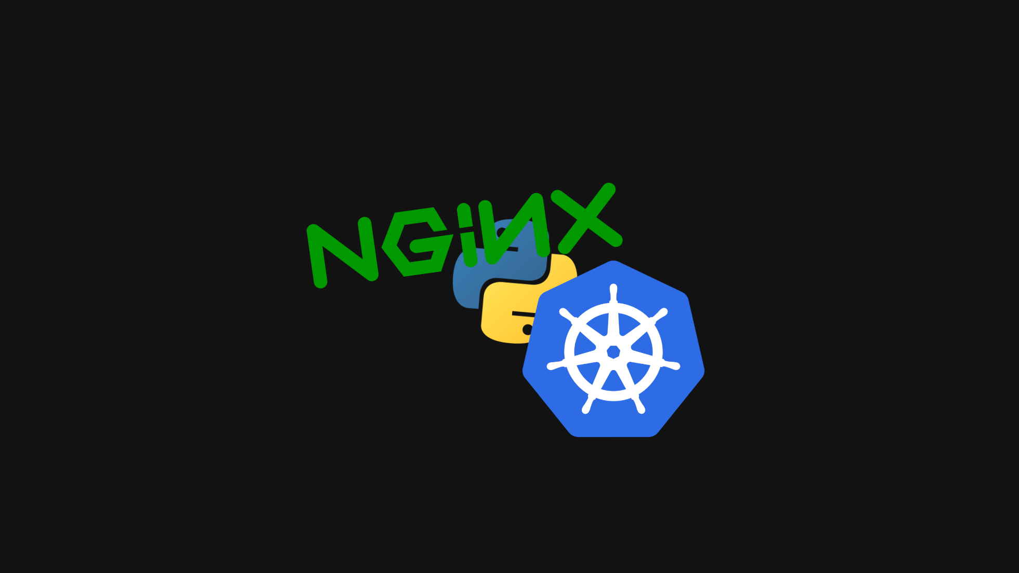
Notes:
It starts with just a simple Python app. It's a one-page marketing site and the rest of the backend. Then at some point you need to slap NGINX on it. You need that reverse proxy, and NGINX is free and trusted. Then you decide, wait, let's go Kubernetes. Slap that on there. Nice easy project. Oh look, some new API services want to sneak in behind your proxy. And there's Docusaurus, asking for a little space for your new developer documentation. Slap that on there. What's that? The dreaded Webflow peeking in? I'm sure many of you have been in this situation before. To get all this working, your NGINX proxy is all of a sudden full of complex routing rules and traffic management policies. All your security in a configuration that's both strict and verbose. It's a front door, but it's a fragile one.

Slide 6
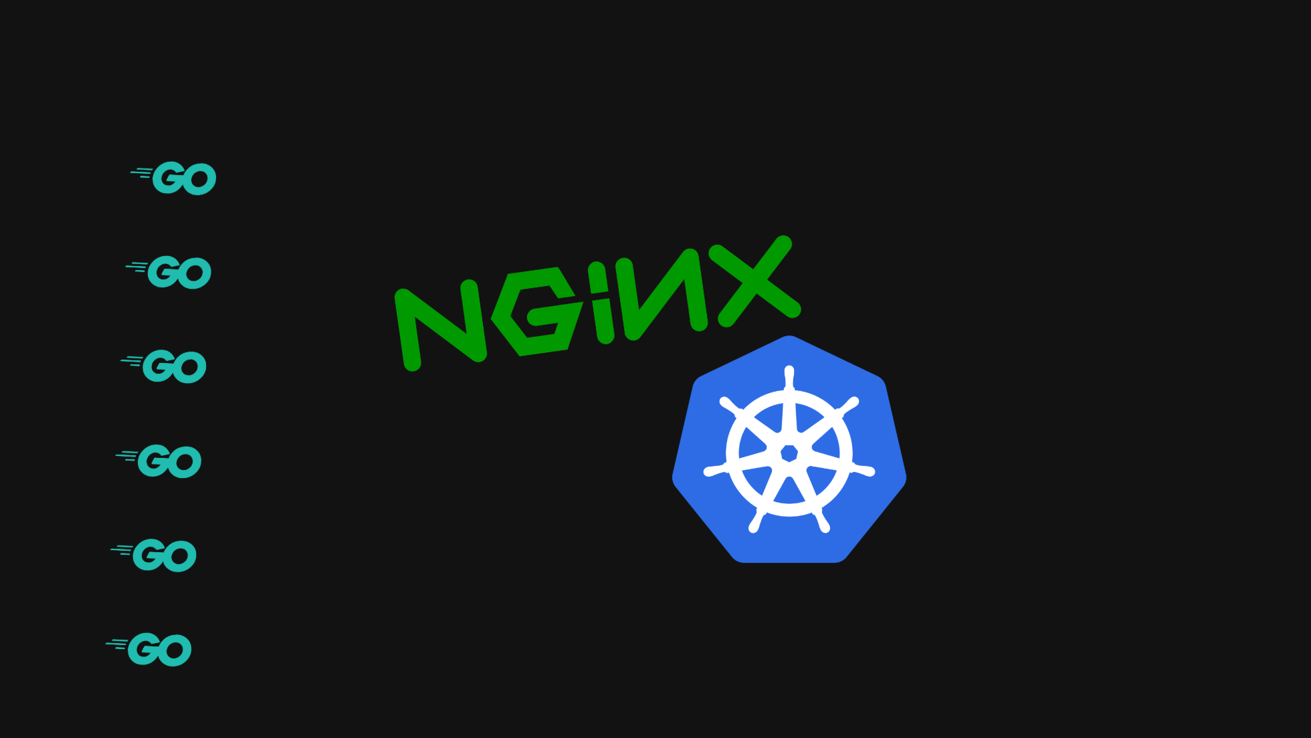
Notes:
It starts with just a simple Python app. It's a one-page marketing site and the rest of the backend. Then at some point you need to slap NGINX on it. You need that reverse proxy, and NGINX is free and trusted. Then you decide, wait, let's go Kubernetes. Slap that on there. Nice easy project. Oh look, some new API services want to sneak in behind your proxy. And there's Docusaurus, asking for a little space for your new developer documentation. Slap that on there. What's that? The dreaded Webflow peeking in? I'm sure many of you have been in this situation before. To get all this working, your NGINX proxy is all of a sudden full of complex routing rules and traffic management policies. All your security in a configuration that's both strict and verbose. It's a front door, but it's a fragile one.

Slide 7
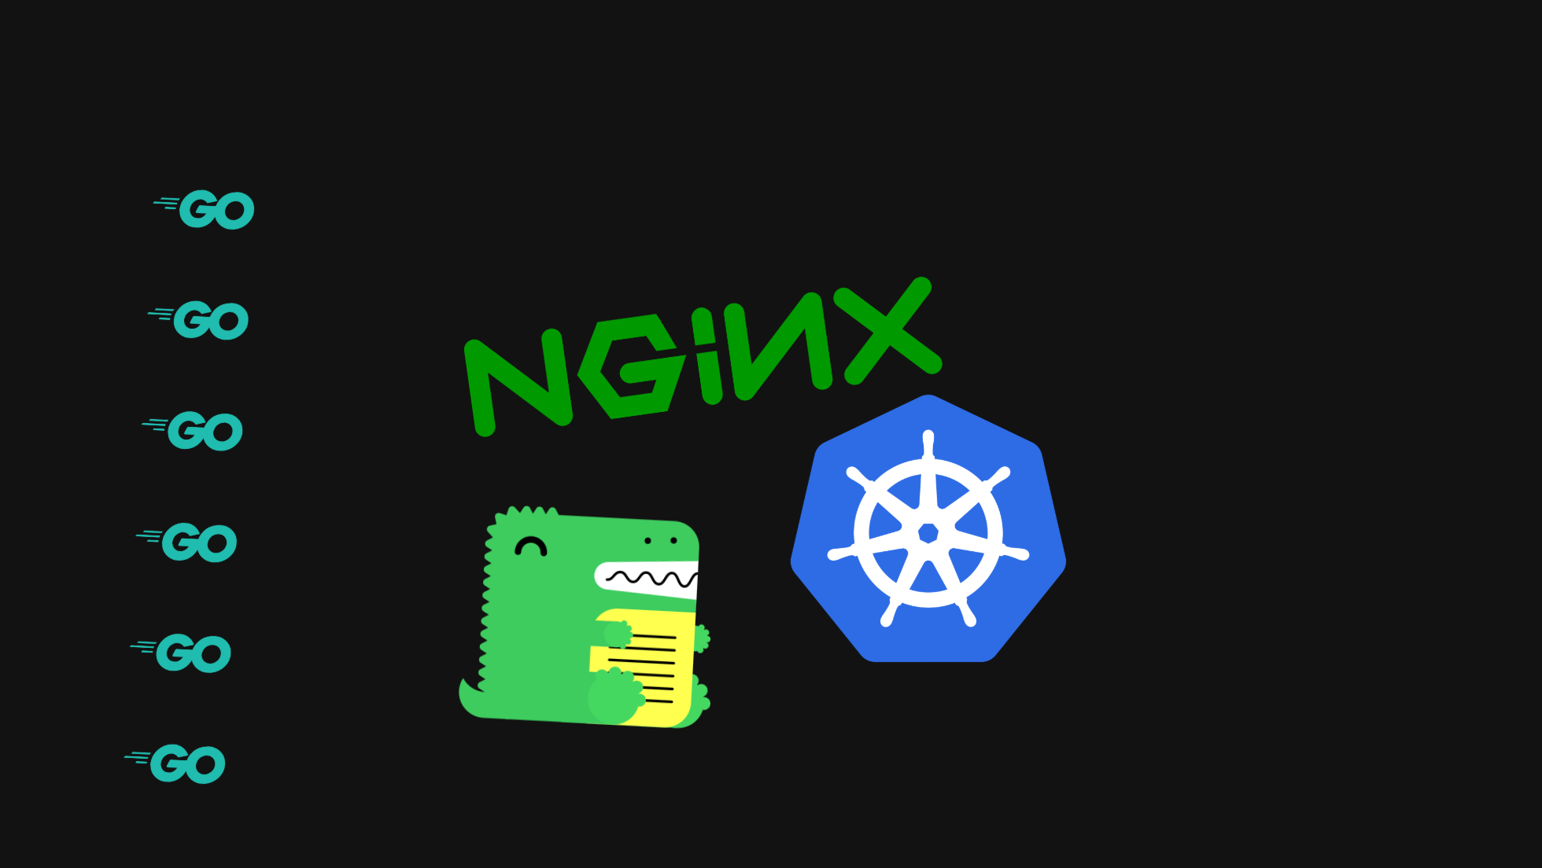
Notes:
It starts with just a simple Python app. It's a one-page marketing site and the rest of the backend. Then at some point you need to slap NGINX on it. You need that reverse proxy, and NGINX is free and trusted. Then you decide, wait, let's go Kubernetes. Slap that on there. Nice easy project. Oh look, some new API services want to sneak in behind your proxy. And there's Docusaurus, asking for a little space for your new developer documentation. Slap that on there. What's that? The dreaded Webflow peeking in? I'm sure many of you have been in this situation before. To get all this working, your NGINX proxy is all of a sudden full of complex routing rules and traffic management policies. All your security in a configuration that's both strict and verbose. It's a front door, but it's a fragile one.

Slide 8
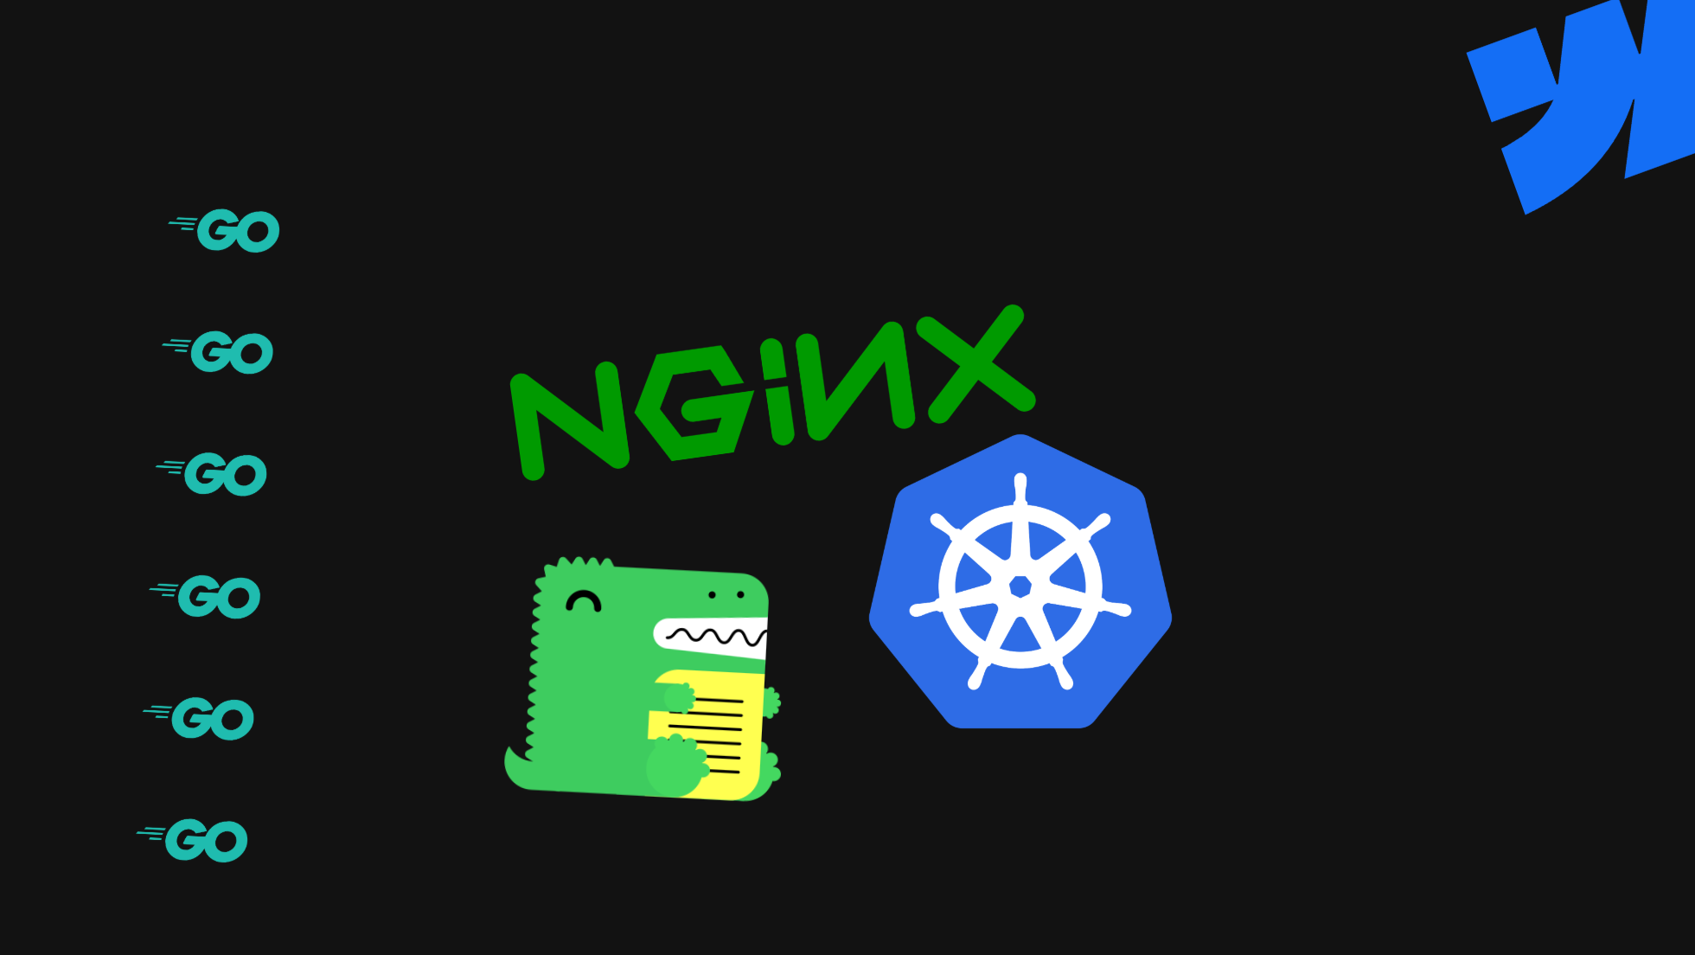
Notes:
It starts with just a simple Python app. It's a one-page marketing site and the rest of the backend. Then at some point you need to slap NGINX on it. You need that reverse proxy, and NGINX is free and trusted. Then you decide, wait, let's go Kubernetes. Slap that on there. Nice easy project. Oh look, some new API services want to sneak in behind your proxy. And there's Docusaurus, asking for a little space for your new developer documentation. Slap that on there. What's that? The dreaded Webflow peeking in? I'm sure many of you have been in this situation before. To get all this working, your NGINX proxy is all of a sudden full of complex routing rules and traffic management policies. All your security in a configuration that's both strict and verbose. It's a front door, but it's a fragile one.

Slide 9
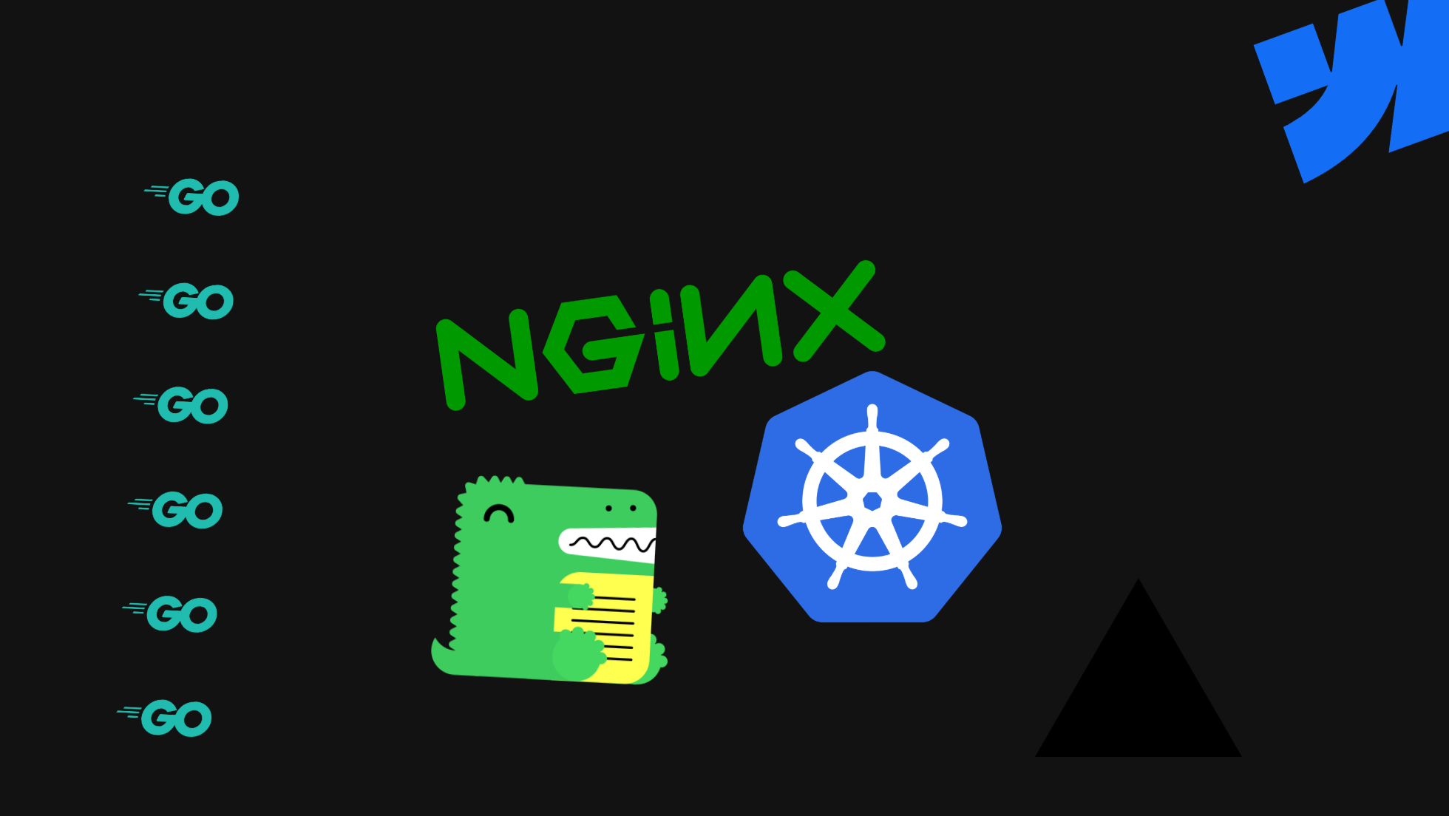
Notes:
It starts with just a simple Python app. It's a one-page marketing site and the rest of the backend. Then at some point you need to slap NGINX on it. You need that reverse proxy, and NGINX is free and trusted. Then you decide, wait, let's go Kubernetes. Slap that on there. Nice easy project. Oh look, some new API services want to sneak in behind your proxy. And there's Docusaurus, asking for a little space for your new developer documentation. Slap that on there. What's that? The dreaded Webflow peeking in? I'm sure many of you have been in this situation before. To get all this working, your NGINX proxy is all of a sudden full of complex routing rules and traffic management policies. All your security in a configuration that's both strict and verbose. It's a front door, but it's a fragile one.

Slide 10
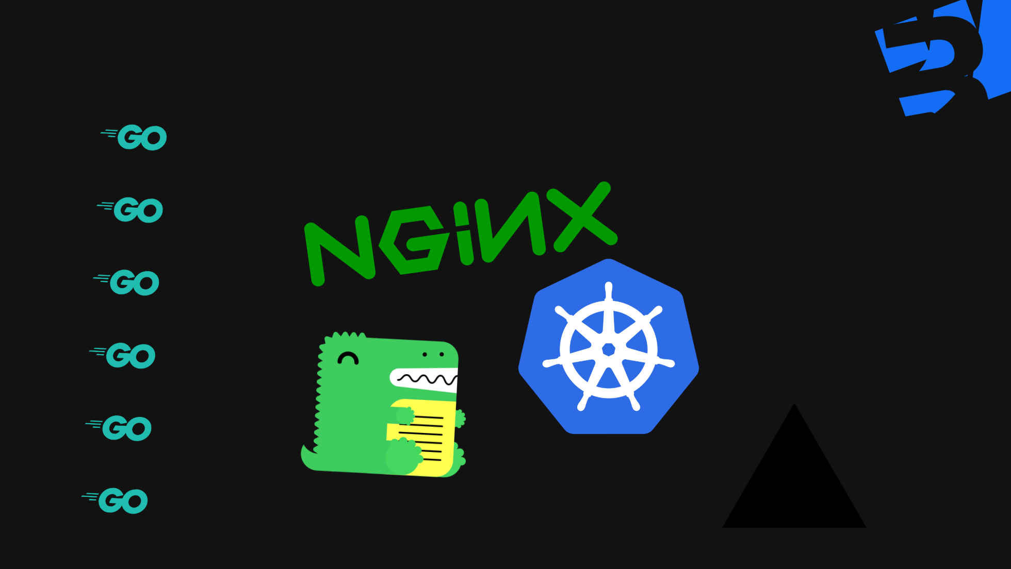
Notes:
It starts with just a simple Python app. It's a one-page marketing site and the rest of the backend. Then at some point you need to slap NGINX on it. You need that reverse proxy, and NGINX is free and trusted. Then you decide, wait, let's go Kubernetes. Slap that on there. Nice easy project. Oh look, some new API services want to sneak in behind your proxy. And there's Docusaurus, asking for a little space for your new developer documentation. Slap that on there. What's that? The dreaded Webflow peeking in? I'm sure many of you have been in this situation before. To get all this working, your NGINX proxy is all of a sudden full of complex routing rules and traffic management policies. All your security in a configuration that's both strict and verbose. It's a front door, but it's a fragile one.

Slide 11
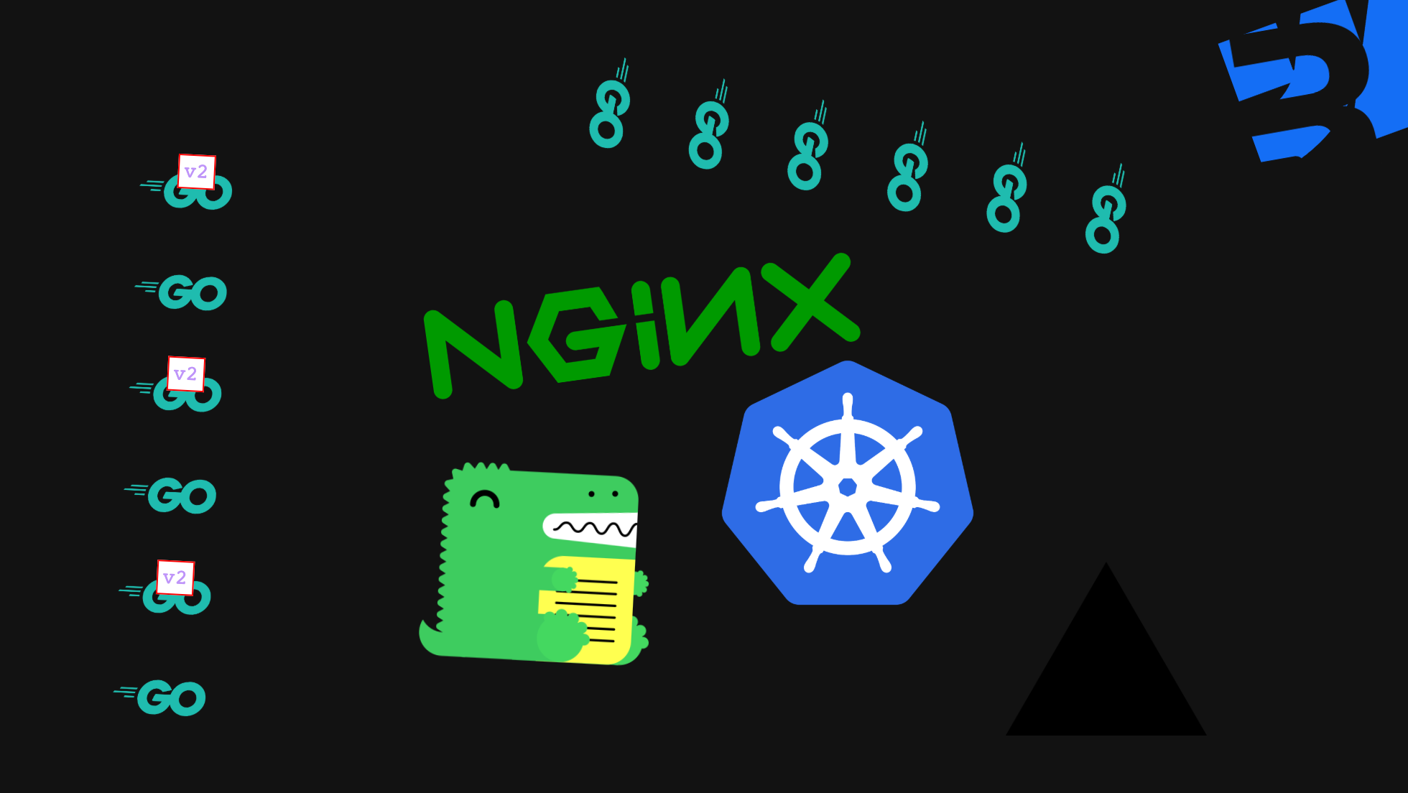
Notes:
It starts with just a simple Python app. It's a one-page marketing site and the rest of the backend. Then at some point you need to slap NGINX on it. You need that reverse proxy, and NGINX is free and trusted. Then you decide, wait, let's go Kubernetes. Slap that on there. Nice easy project. Oh look, some new API services want to sneak in behind your proxy. And there's Docusaurus, asking for a little space for your new developer documentation. Slap that on there. What's that? The dreaded Webflow peeking in? I'm sure many of you have been in this situation before. To get all this working, your NGINX proxy is all of a sudden full of complex routing rules and traffic management policies. All your security in a configuration that's both strict and verbose. It's a front door, but it's a fragile one.

Slide 12
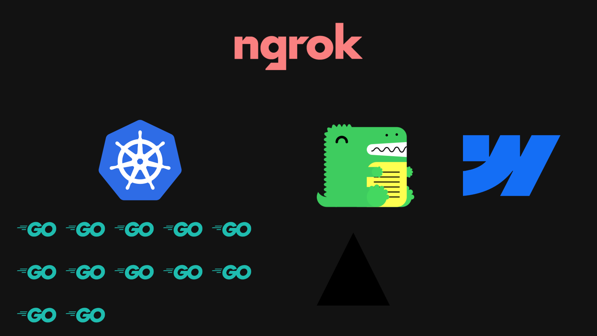
Notes:
1. An API gateway brings order to that chaos.

Slide 13
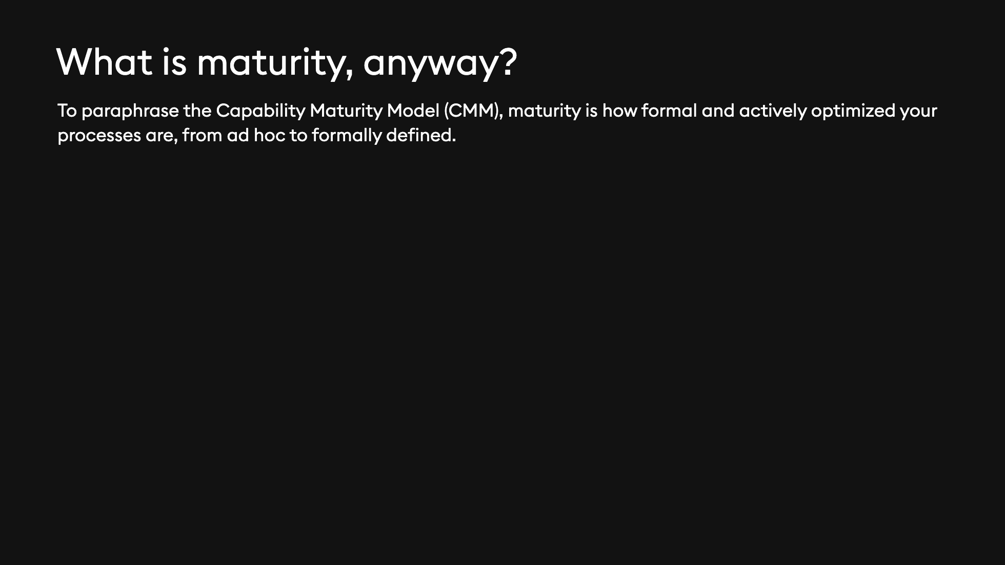

Slide 14
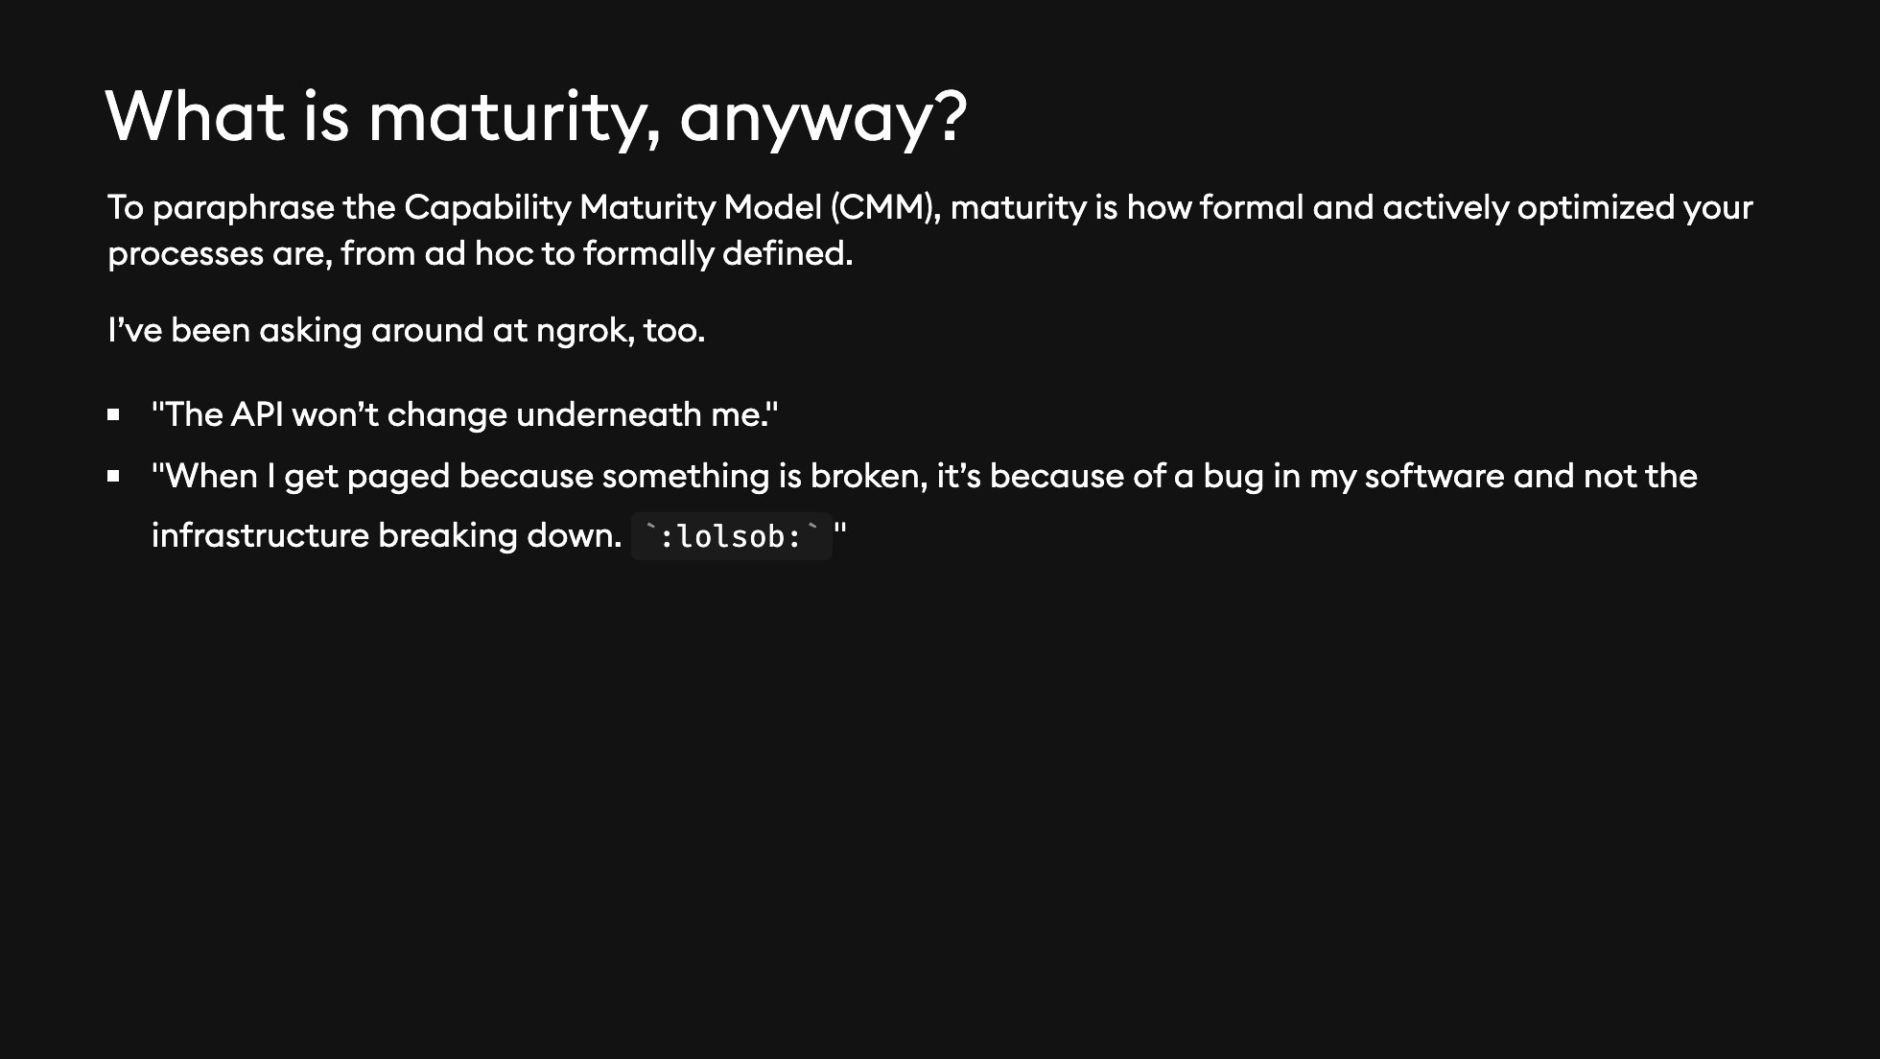

Slide 15


Slide 16
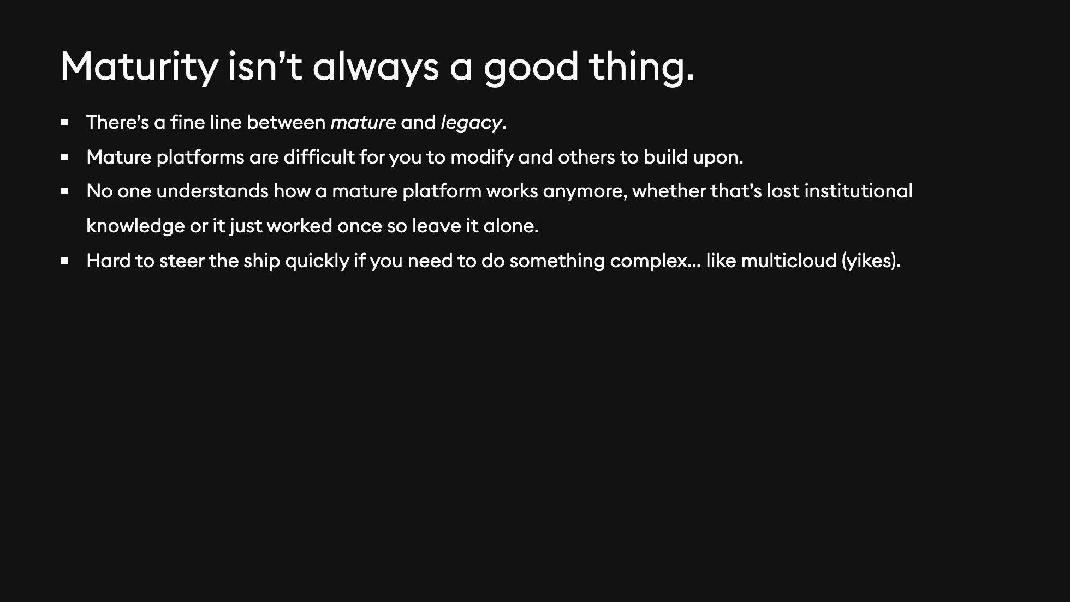

Slide 17
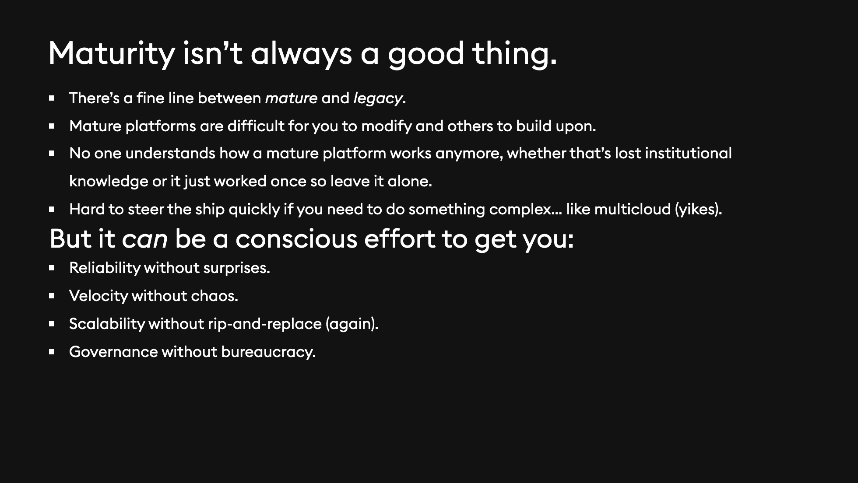

Slide 18
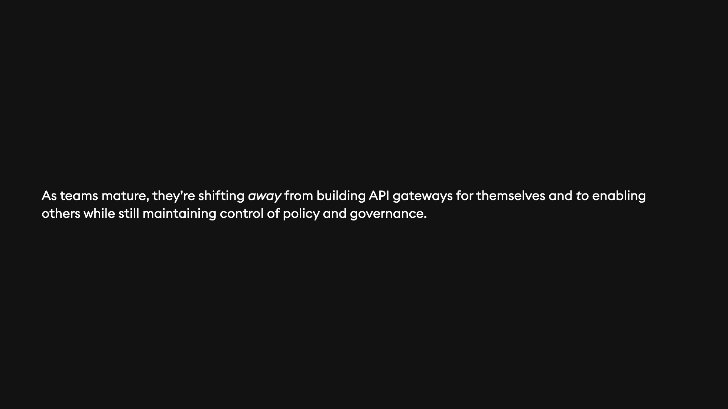

Slide 19

Notes:
Years ago, I was in a room much like this one in Detroit, Michigan. I was with 15 or so CTOs and tech leaders from the heaviest hitters of CNCF's end user community. Can't name names, but they were big ones. They were there to talk about CNCF's Cloud Native Maturity Model and how they could apply it to their organizations, particularly from a platform engineering perspective. They loved having this kind of roadmap to look forward to, but still struggled. CNCF is agnostic: - They won't tell us what technology or projects to use! - They won't tell us how to get better at a single technology or product! (except maybe K8s itself) Fast forward, and I'm in a place where I think about and write about and build around API gateways all the time. Why not apply this methodology to a specific technology?

Slide 20
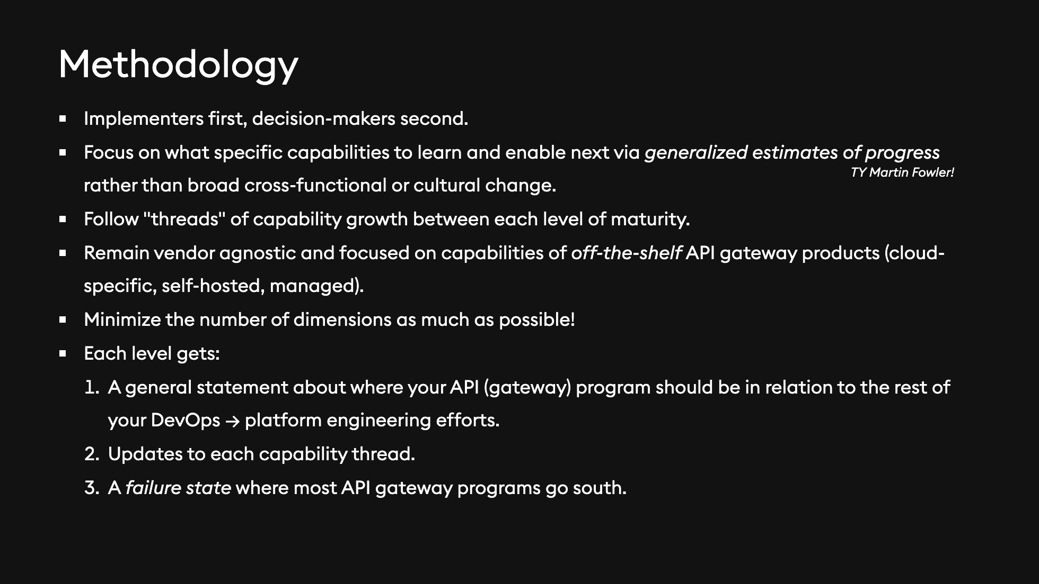
Notes:
1. I wanted to align maturity with capabilities and implementation rather than trying to focus on platform engineering as a whole. An API gateway won't drive an entire infra organization. 2. This includes cloud-specific, self-hosted, and managed gateway products, but if you're creating your own API gateway, go read some engineering blogs from Uber or Tinder. 3. I want this to be (at least for now) simple. That means something you can actually read, self-identify, and implement—not need a professional services team to do that for you.

Slide 21
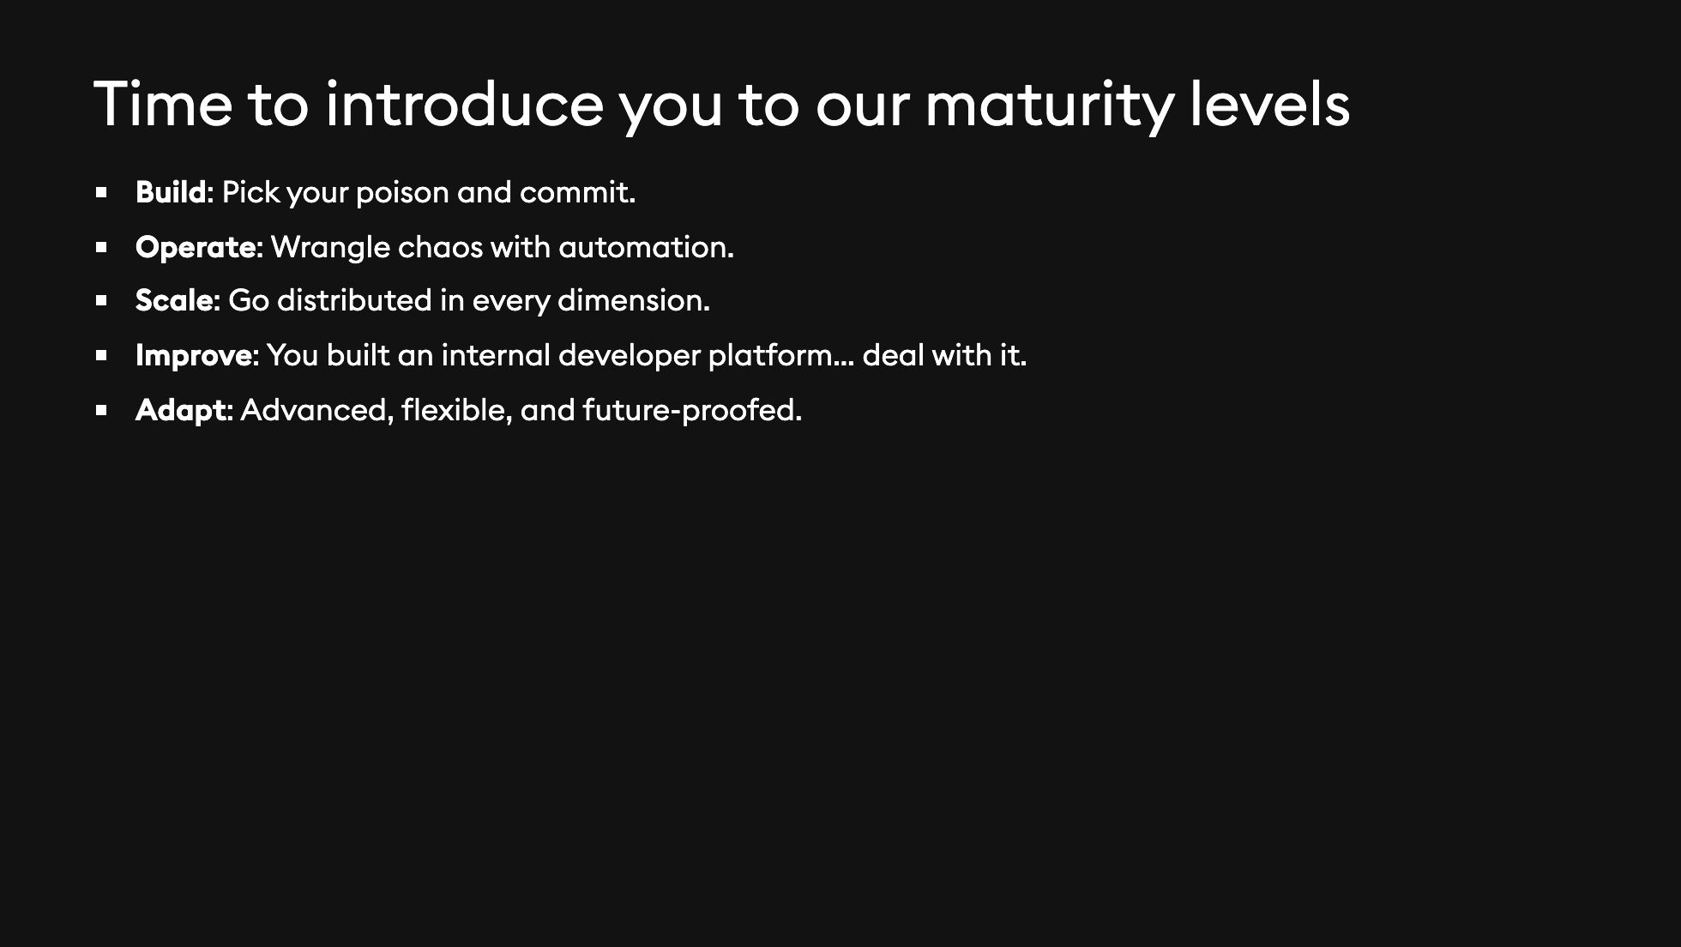
Notes:
1. I'm trying to be a little cheeky with these, but I hope you can see the progression from building for yourself toward building toward others.

Slide 22
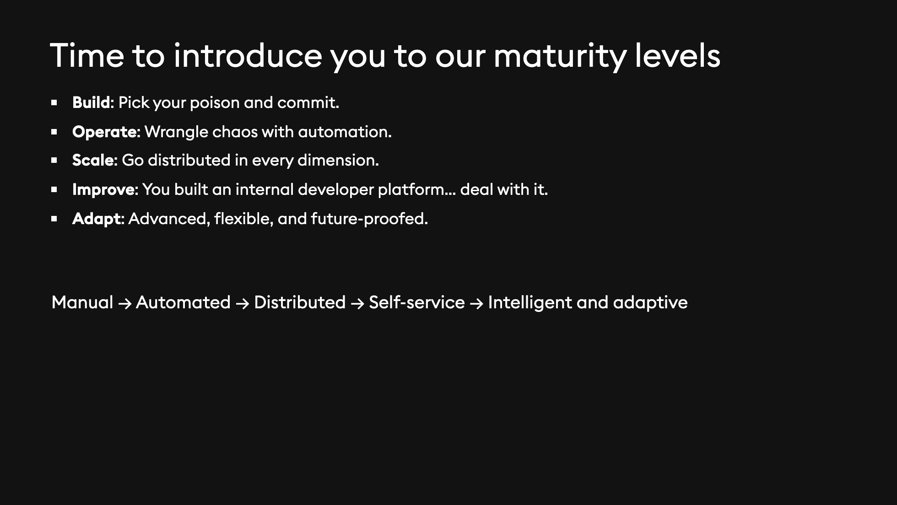
Notes:
1. I'm trying to be a little cheeky with these, but I hope you can see the progression from building for yourself toward building toward others.

Slide 23
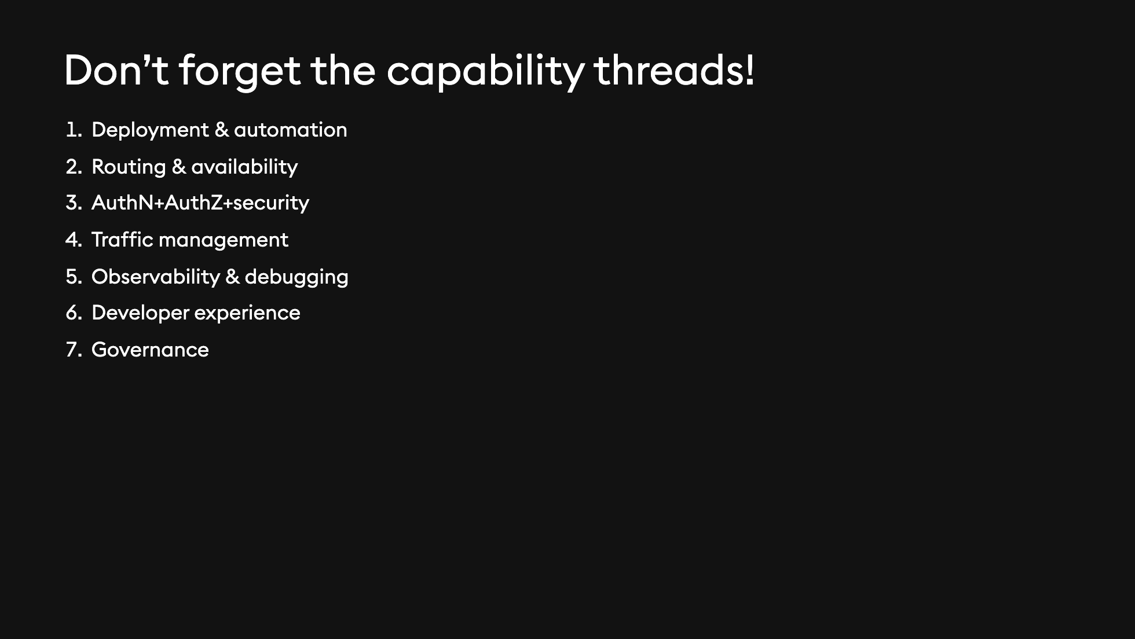
Notes:
1. I've taken some liberties with these groups, but I want to minimize the dimensions as much as possible.

Slide 24
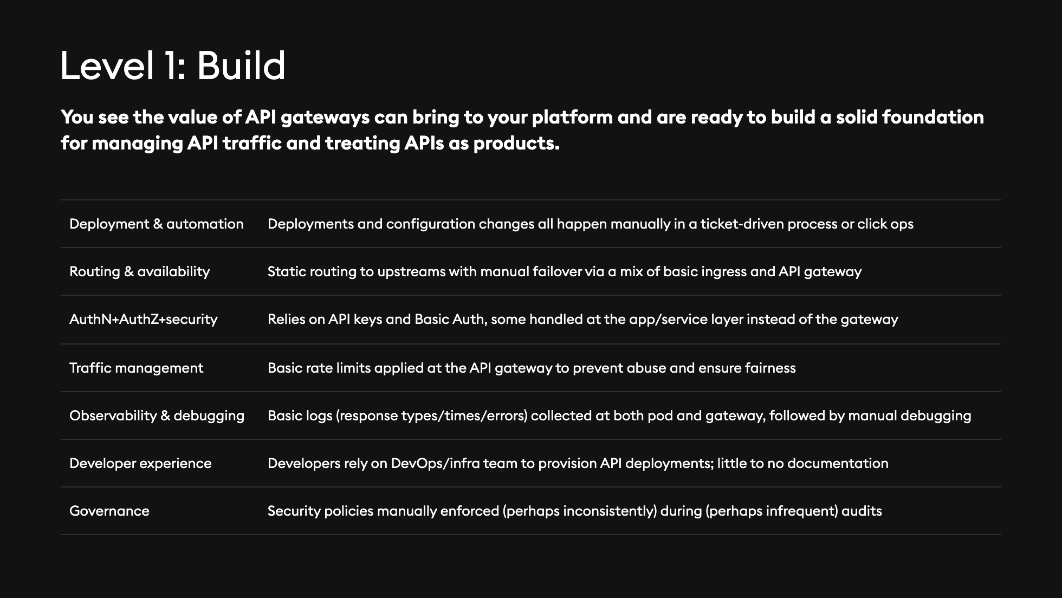
Notes:
1. The most consistent thing is inconsistency here. Some apps still haven't offloaded functions like auth, and the idea of a consistent front door isn't solid yet. 2. Everything is kind of hard. 3. Kubernetes is mostly used as an infrastructure layer—think routing.

Slide 25
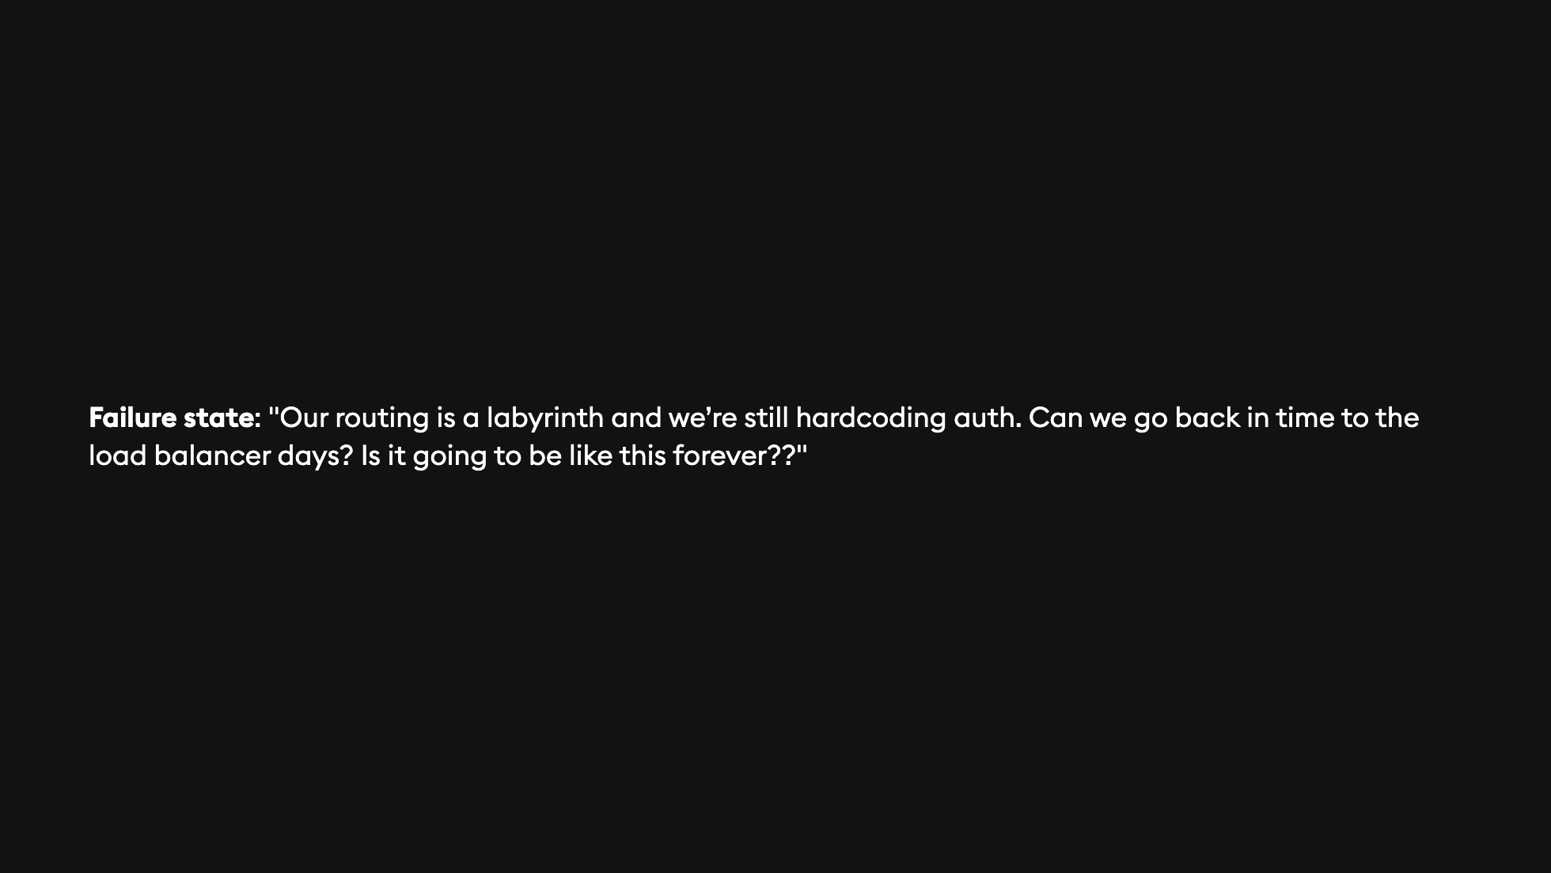
Notes:
1. Things start ad-hoc and they stay ad-hoc.

Slide 26

Notes:
1. Things start ad-hoc and they stay ad-hoc.

Slide 27
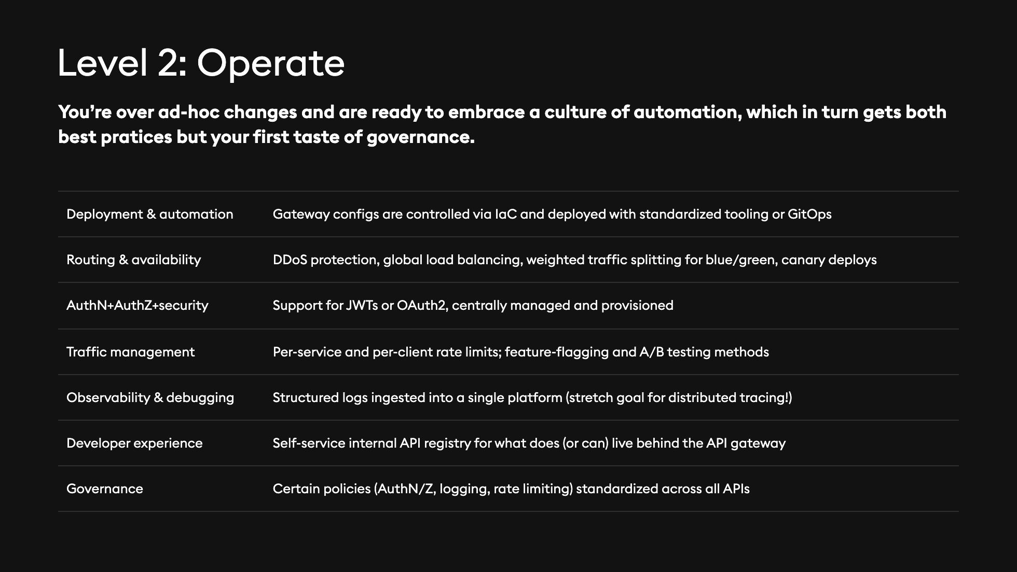
Notes:
1. You replacing ad-hoc steps with automation. 2. You take your first steps to apply those essential policies like auth across all your APIs with a single front door that fans out to everything else with the developers being none the wiser. 3. You're starting to use more native K8s tooling to configure your gateways and make it all management. Does the word 'operator' ring a bell for anyone?

Slide 28
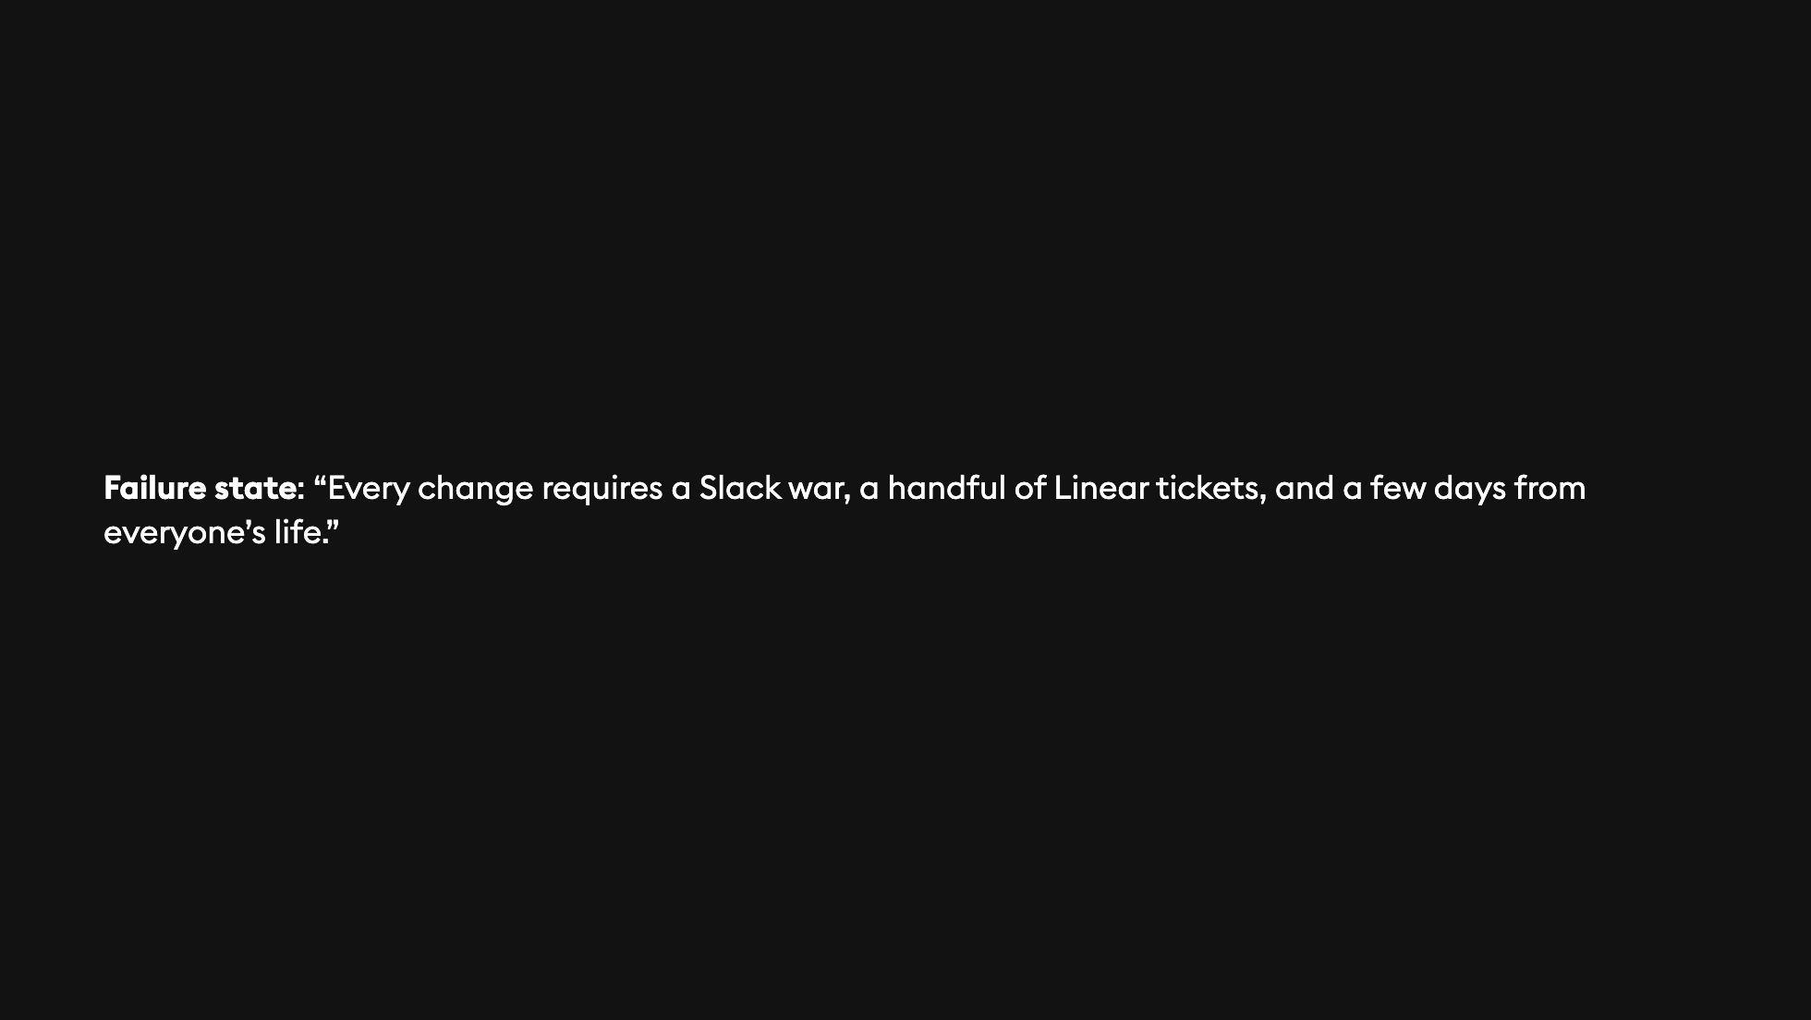

Slide 29
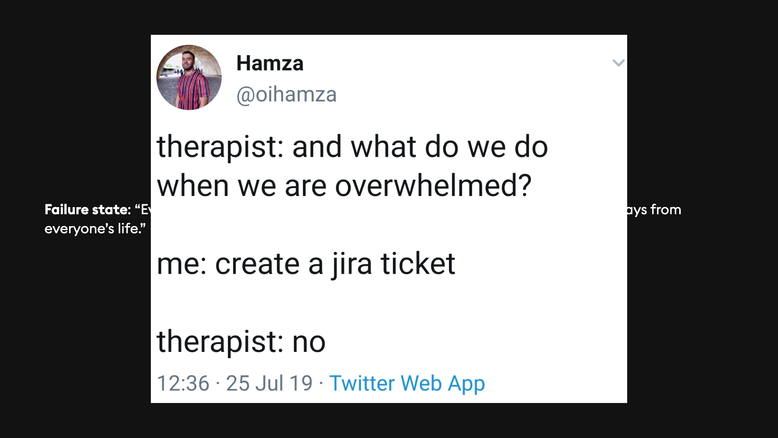

Slide 30
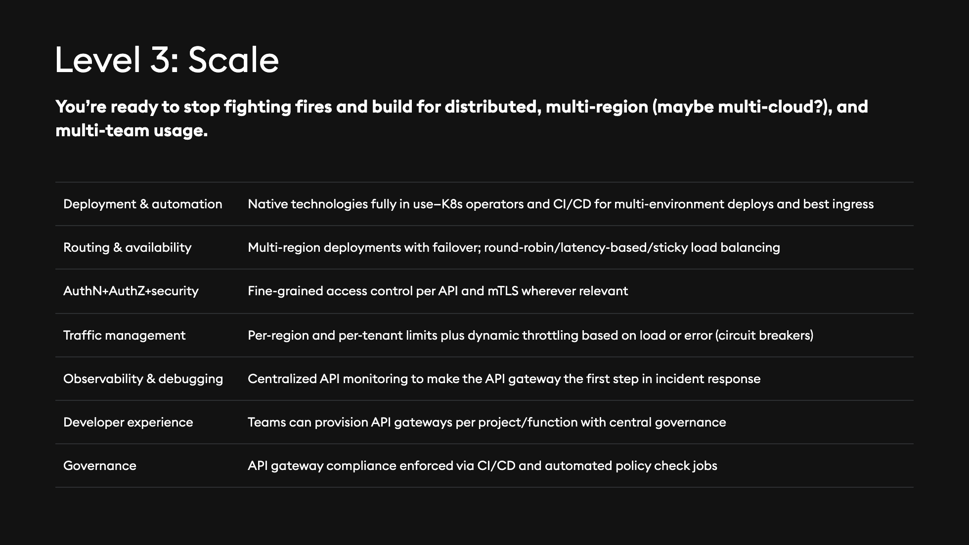
Notes:
1. This is the multi-everything stage. You get distributed and you get a little bit dynamic. 2. Even if you're not ready to actually implement some of these big engineering efforts, you have a plan of action for both the people and technology required. 3. You're giving developers the ability to use your API gateway's K8s tooling, which is the first step in becoming a platform.

Slide 31
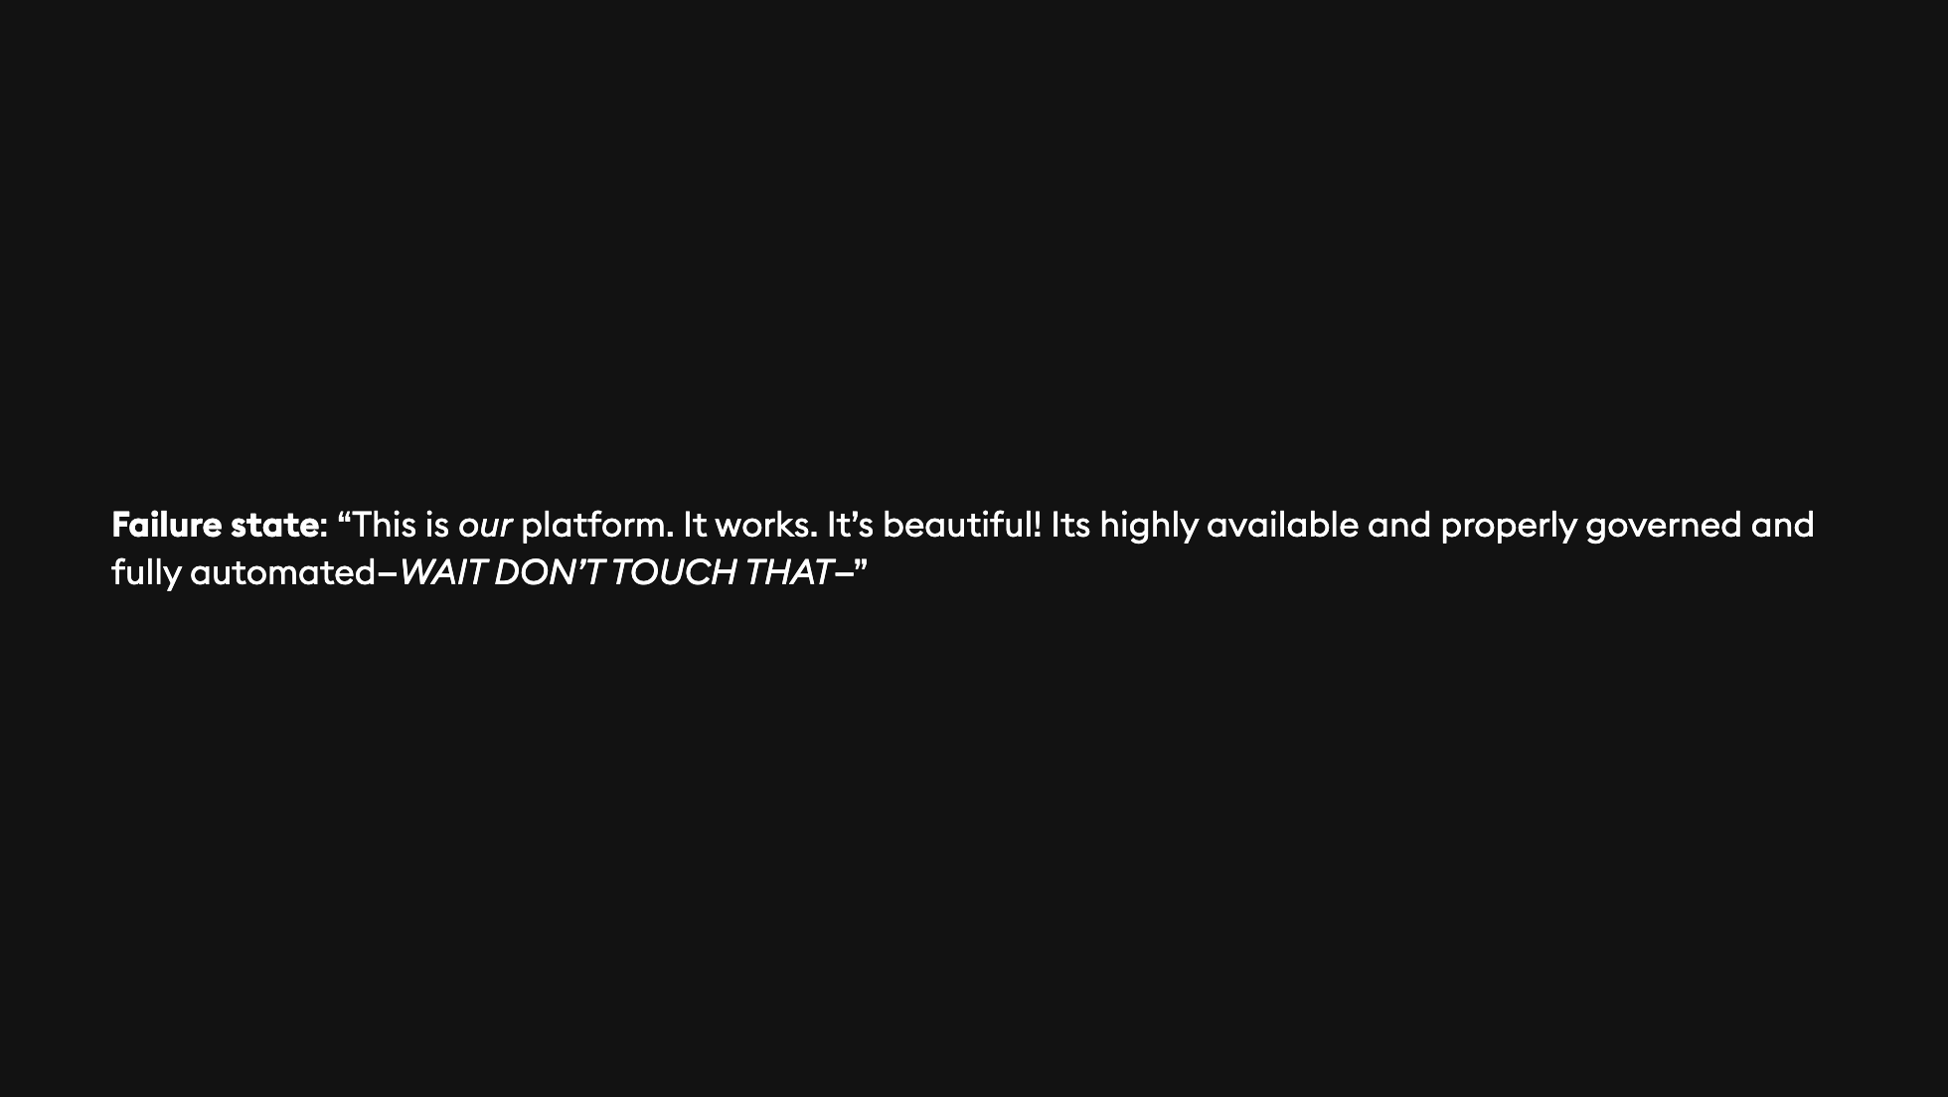

Slide 32


Slide 33
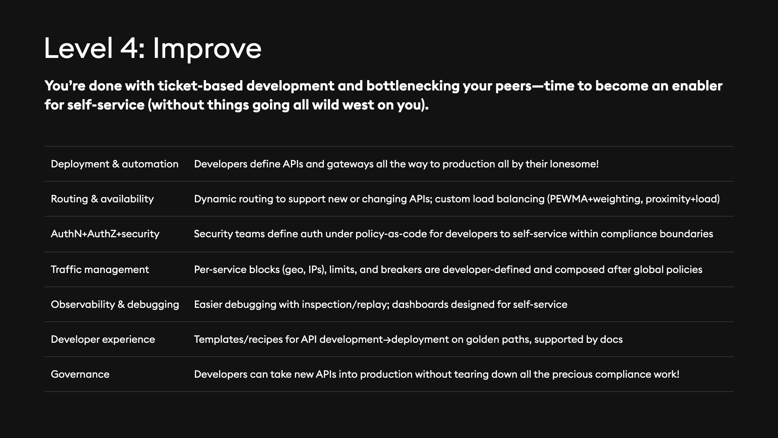
Notes:
1. This is where your role evolves completely from building for yourself to building for others. You're doing everything in your power to not be a gatekeeper for others. 2. Your end goal is to make your platform better than building on monoliths—you give them more features built-in, more metrics, more dashboards, better error handling. 3. This is a big orchestration of IaC and Policy as Code that keeps people on the right rails and never gets in their way—composability makes a big difference to allow them to build on top of your platform, not undermine or override it.

Slide 34
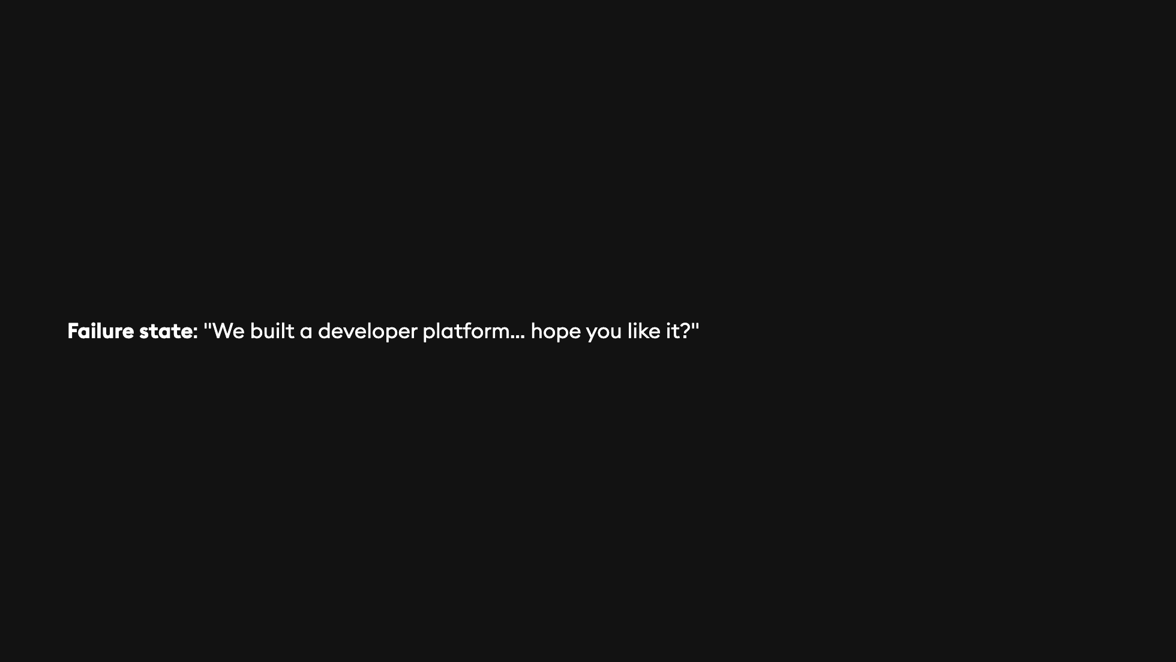

Slide 35


Slide 36
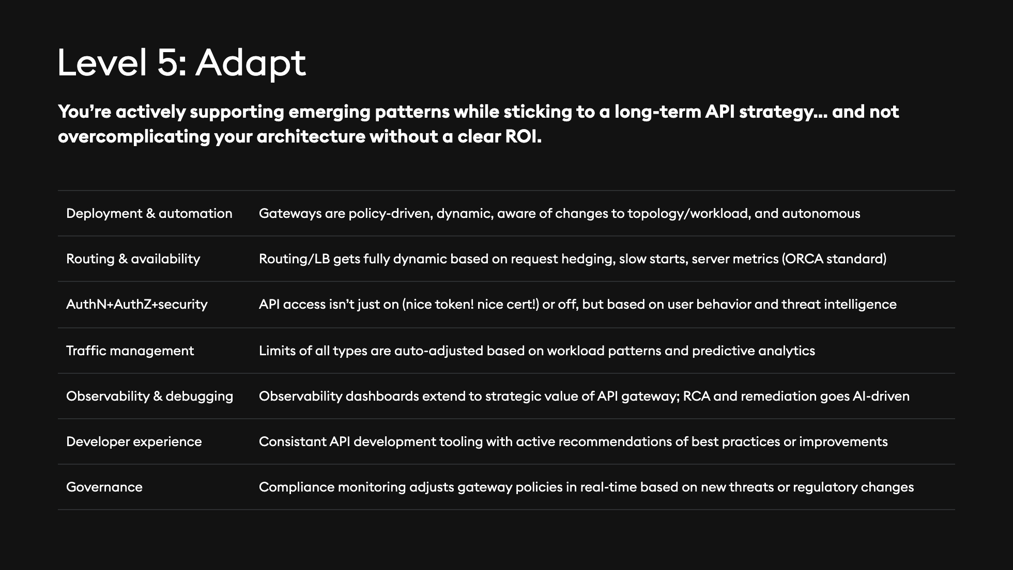
Notes:
1. This is where things get real fuzzy but maybe also fun?. A lot of this isn't baked into API gateway products directly, so that means lots of integrations and data egress and so on. 2. I could've honestly put *AI AI AI* on every one of these, but it's not quite clear whether that's actually the future of this slice of technology. 3. Every part of this is based on Kubernetes tooling and telemetry—nothing is static any more.

Slide 37
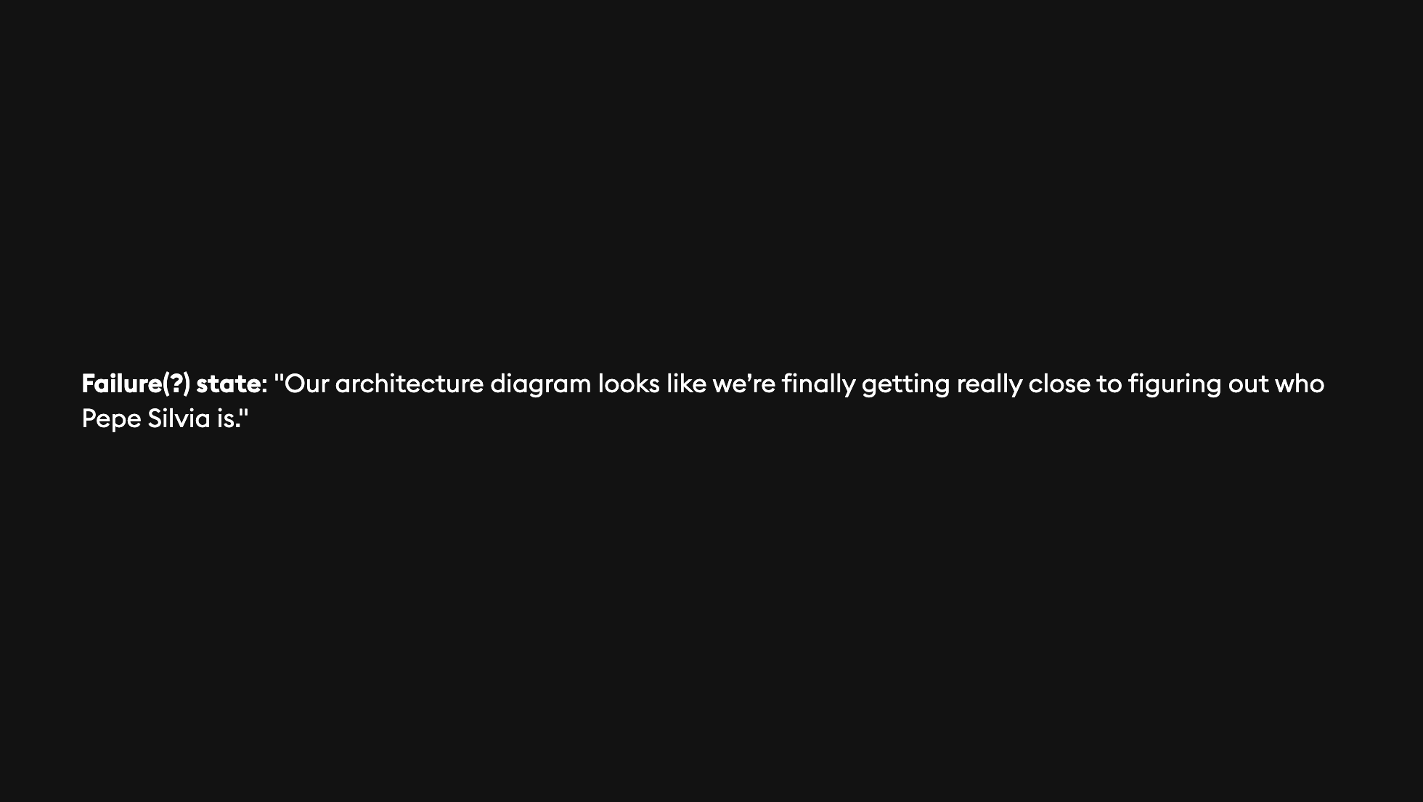
Notes:
1. Let's be honest—if you've gotten to this point, you really haven't failed at all.

Slide 38
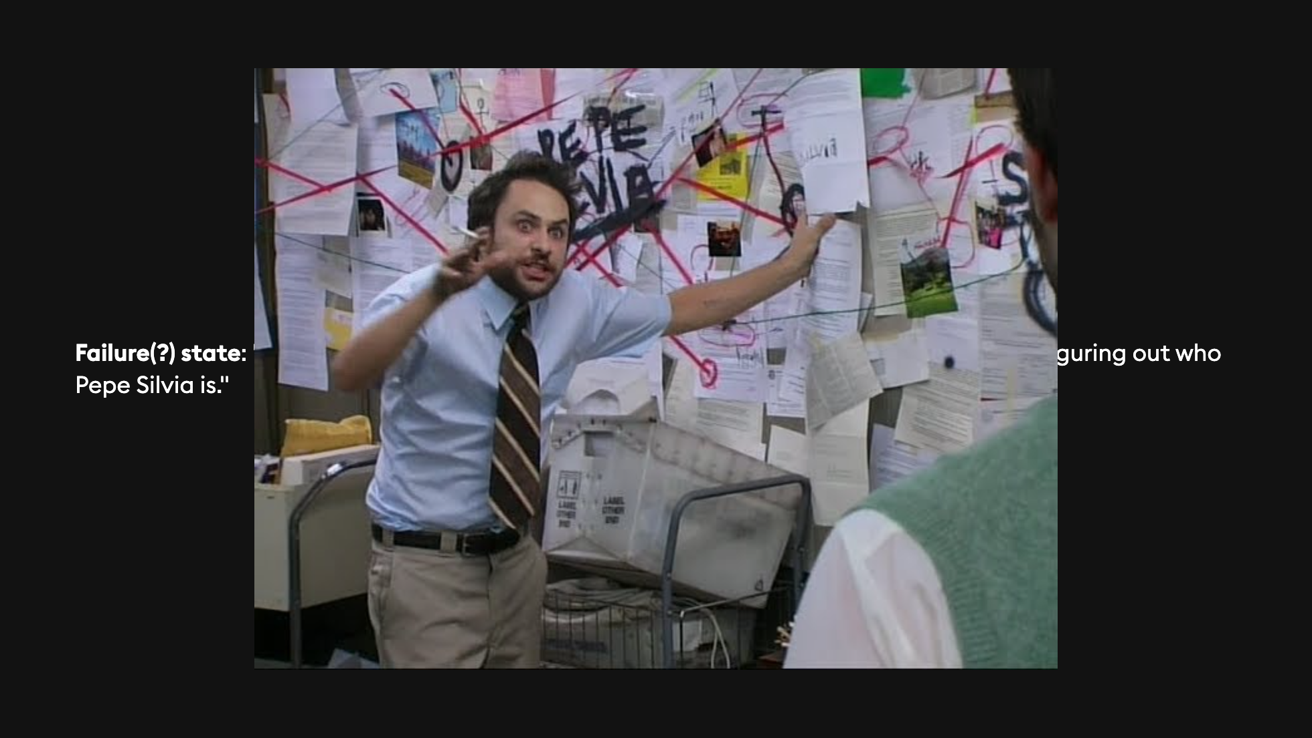
Notes:
1. Let's be honest—if you've gotten to this point, you really haven't failed at all.

Slide 39


Slide 40
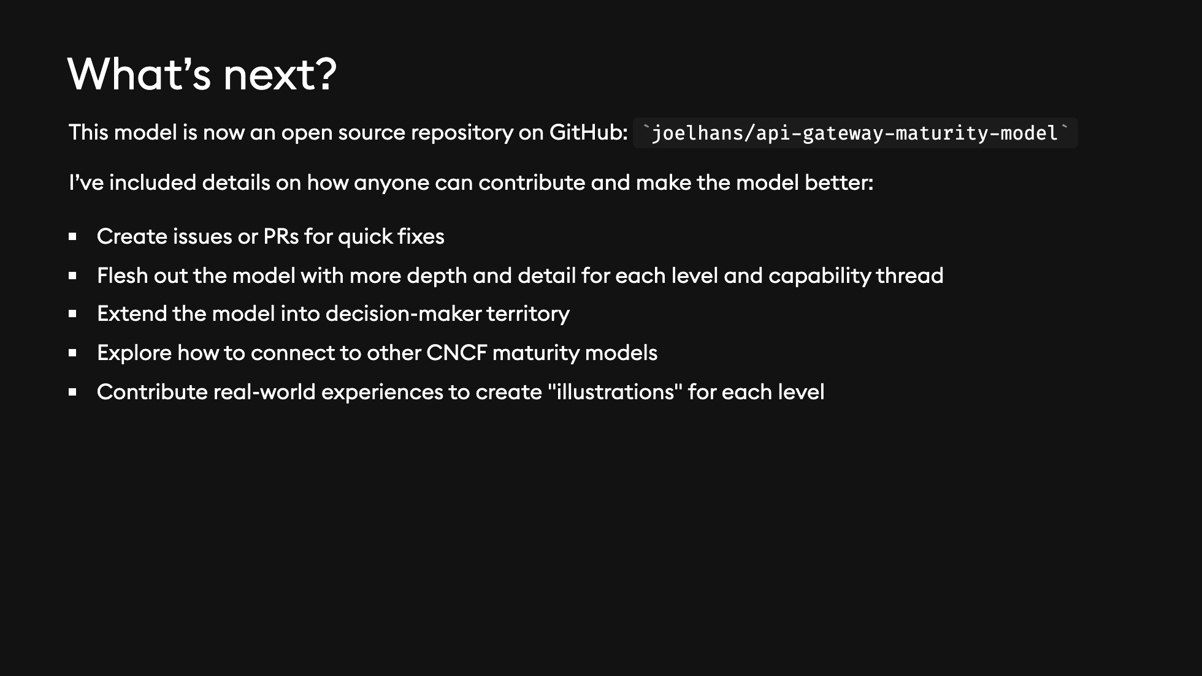

Slide 41
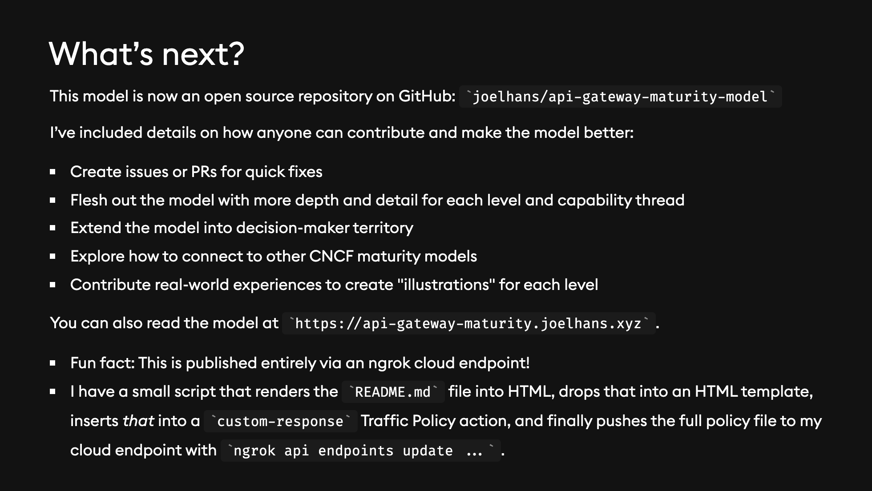

Slide 42
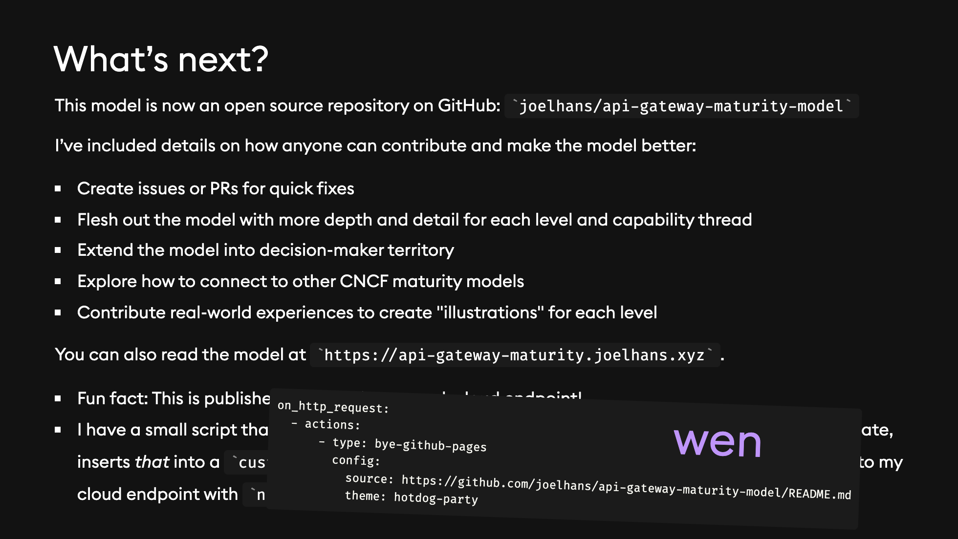

Slide 43


